Slide 1
Sentence similarity and embeddings
John Brandt
Advanced NLP
10/23/2018
Notes:
Afternoon, my name is John Brandt and today I’ll be giving a lecture on sentence similarity and embeddings.
I am a second year master’s student at the school of Forestry, where NLP has been integral to a lot of my research.
A lot of the more cutting-edge methods discussed in the later part of this talk were thus very relevant to my own interests and I hope they can be englightening to yours.

Slide 2
Agenda
Background and history of embeddings
Word2vec
GloVe
Sentence embeddings
Doc2vec
Skip-thoughts
Quick-thoughts
Universal sentence embeddings
Discussion
Notes:
We will begin with a crash-course on word2vec and glove, to make sure that we are all on the same page when discussing their hyperparameters and objectives later on.
Afterwards, we will consider four types of sentence embeddings in depth: Doc2Vec, skip-thoughts, quick-thoughts, and universal sentence embeddings.
We will end with a quick overview of a supervised method, InferSent, and then close with a discussion and a framework for choosing between the options.

Slide 3
Why
Words do not intrinsically lend themselves to numerical computations
One hot encoding and term-document matrices are sparse solutions
Embeddings are dense representations of words that convey similarity
There is a need for generalizable and universal embeddings that can be pre-trained on a large general corpus and transferred a to domain-specific corpus
Notes:
Embeddings were developed to solve the problem of sparsity caused by one-hot encoding.
Embeddings are dense representations of words that convey similarity. However, they learn biases from their training set and are rarely generalizable to new corpuses.
3rd BP.

Slide 4
Background
Embeddings encode words or sentences into dense vectors.
word2vec and gloVe are the most common approaches
Word2vec uses the hidden layer of a surrogate shallow neural network where the output is the prediction of a word given its surrounding words or vice versa.
gloVe is a count-based weighted least squares optimization
Embeddings are a large part of any modern NLP architecture
Sentiment analysis, classification, translation, IR
Most embeddings are pre-trained and applied with transfer learning

Slide 5
Word2vec - Skipgram vs. CBOW
Skipgram: Predicts context given word
Better with less data, better for rare words
____ _____ _____ rainy ____ _____ _____
CBOW: Predicts word given context
Faster to train than skip-gram, better accuracy for frequent words
The weather is ______ and very cold
Notes:
Word2Vec can be modelled via two different objectives and architectures.
Skip-gram predicts the context given a word. It is typically best when there is less training data (compute time) or many rare words.
CBOW (continuous bag of words), instead predicts the word given its context. It is faster to train and may have better accuracy for frequent words.

Slide 6
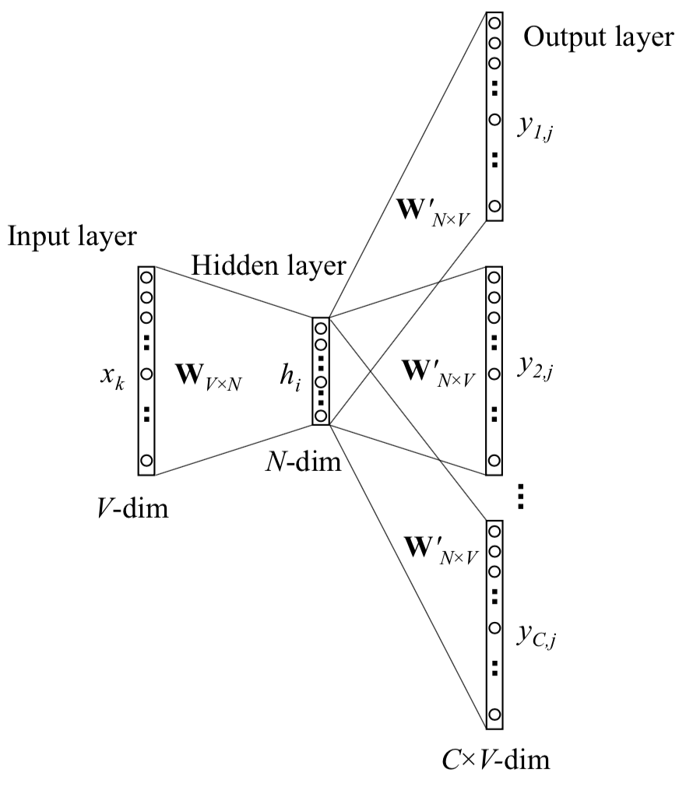
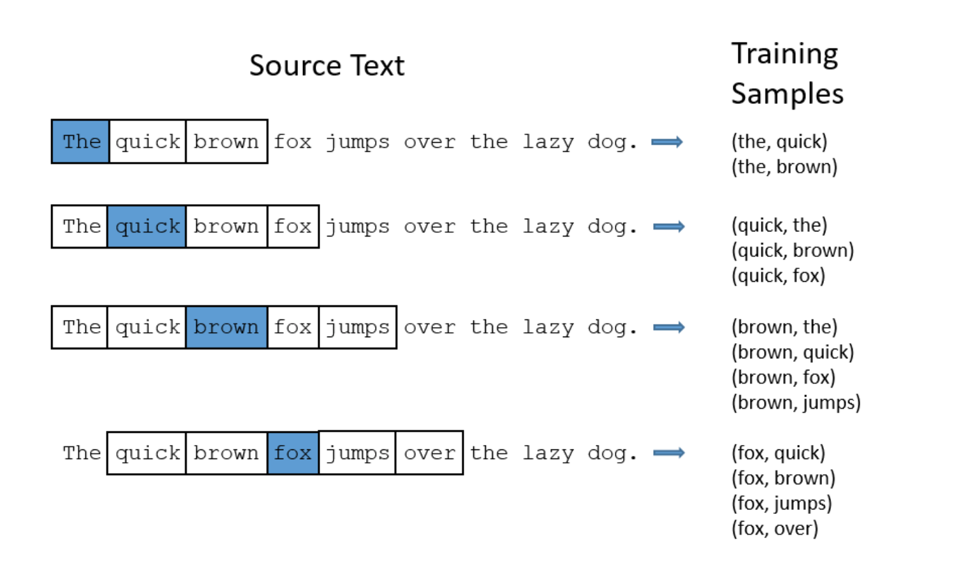
Word2vec - Skipgram
Xin Rong, 2016; http://mccormickml.com/2016/04/19/word2vec-tutorial-the-skip-gram-model/
Notes:
Here is a visual representation of the skipgram objective.
The target word is the input, and the context words are the output.
For a given window size, construct word, context pairs. The, quick, the, brown, quick, the etcetera.
For each input word in the vocabulary, construct a one-hot-encoded vector that is the input. For each training sample, maximize the conditional probability of observing the actual context word given the input word. Output C(window size) multinomial distributions representing the probability of the word being in the context of the input.
At each step, calculate the update equation based upon the loss, which is the prediction error summed across all context words in the output layer.
Xin Rong, 2016

Slide 7
Word2vec -Tuning parameters
Epochs– 75-150
Weights – 200-500
Window size (2-15)
Negative sampling size (0-20)
Subsampling rate (0.001 default)
N-grams and phrases

Slide 8
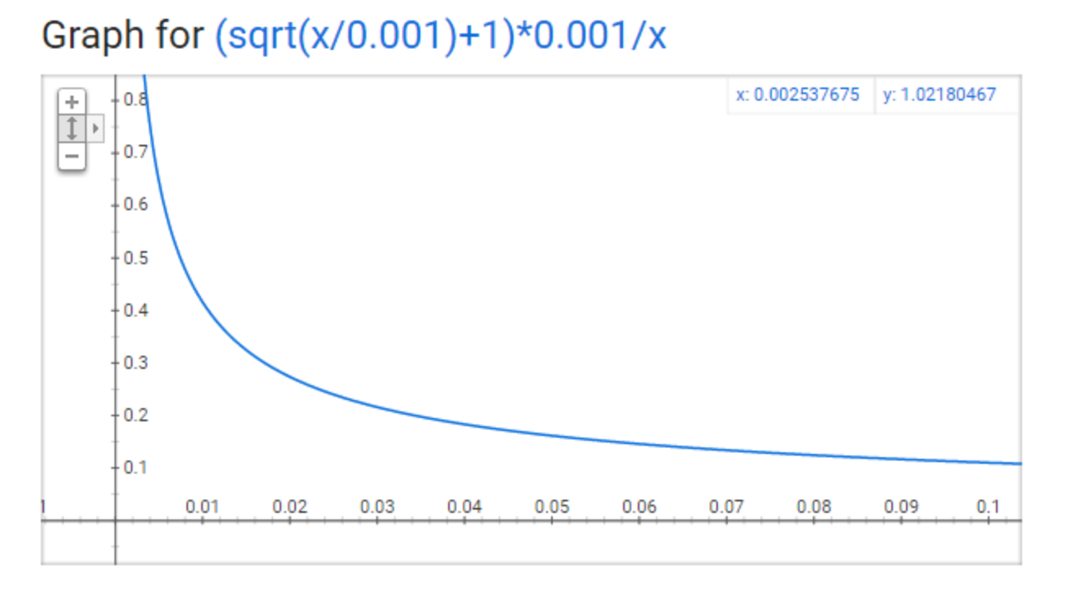
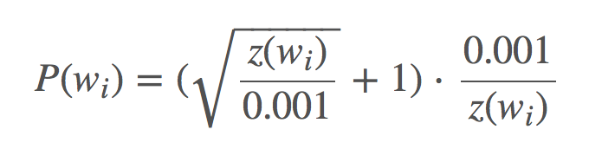
Word2vec - Subsampling
http://mccormickml.com/2017/01/11/word2vec-tutorial-part-2-negative-sampling/
Stopwords and very frequent words in models where polysemy is not modeled are problematic because they are likely to appear in many different contexts but only receive one embedding.
Chance to drop any word from an input based on its frequency
Z(w_{i}) is fraction of the words frequency
Notes:
If Zwi is less than 0.0026, it will not be dropped. 50% drop rate at 0.00746
96.7% drop rate when z(wi) is 1
The 0.001 is the tuning parameter. Increasing it will decrease the subsampling rate - words will be kept more frequently.

Slide 9
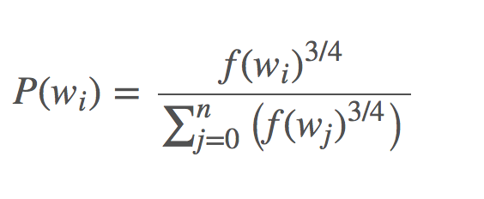
Word2vec - Negative sampling
Big idea: Each training sample updates a small amount of weights
Output of the network is a one-hot vector, so it is sparse
If update all, say 300x10000 = 3M, if update 5+1 = 6*300 = 1,800
Instead of updating all weights, update 5-20 “negative” (0) weights randomly, as well as the positive weight
Negative samples chosen from unigram distribution – frequent words selected more often. ¾ power is empirical
Notes:
McCormick, C. (2017, January 11). Word2Vec Tutorial Part 2 - Negative Sampling. Retrieved from http://www.mccormickml.com

Slide 10
gloVe
While word2vec is predictive, gloVe is count-based
Word2vec optimizes a loss function (predicting target word given context) with SGD
gloVe performs dimensionality reduction on normalized log word x context co-occurrence to create singular vector concatenating representations of each context
Context is optimized so that the dot product of two vectors is the log # of times that the words are within k distance of each other
Log-bilinear model with WLS objective
Notes:
http://clic.cimec.unitn.it/marco/publications/acl2014/baroni-etal-countpredict-acl2014.pdf

Slide 11
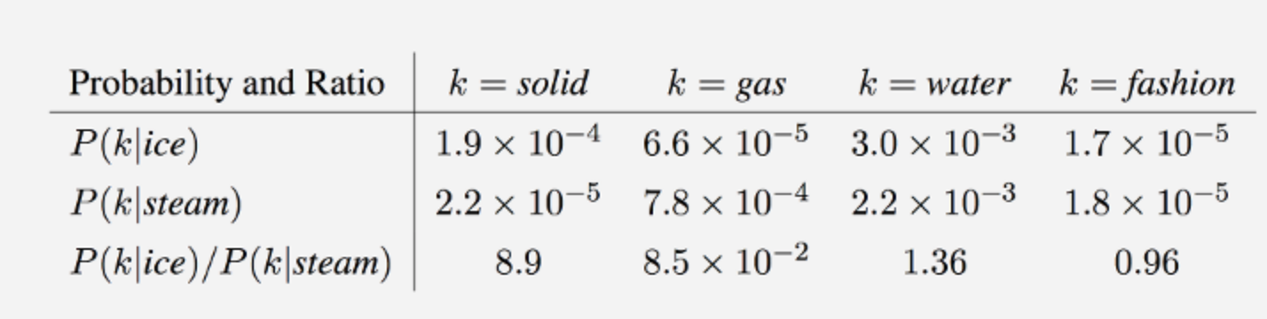
gloVe
https://nlp.stanford.edu/pubs/glove.pdf
Notes:
https://nlp.stanford.edu/projects/glove/
https://nlp.stanford.edu/pubs/glove.pdf
X_Ij = arbitrary difference between word and context word, so makes them interchangeable b_i and b_j are bias terms that come from log(i) because it is independent of j V is size of vocab
F(X_ij) is a weighting function

Slide 12
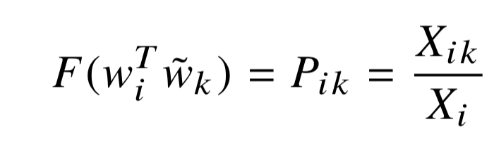
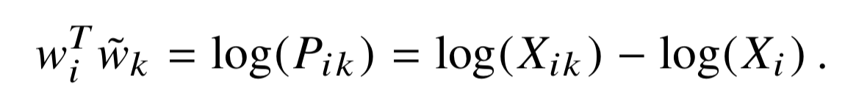
gloVe
Word-word co-occurrence is matrix X
X_{ik} is number of times any word is in context of i
P_{ij} = P(j|i) = X_{ij}/X_{i} = prob j is in context of i
Notes:
Log (P_ik) and log(X_ik) would have exchange symmetry if not for log X_i. but X_i is not dependent on k, so we can absorb it into the bias term for the embedding w_i

Slide 13
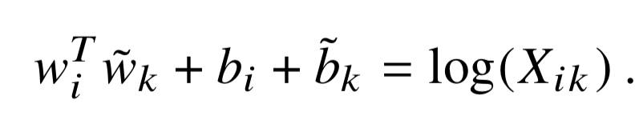
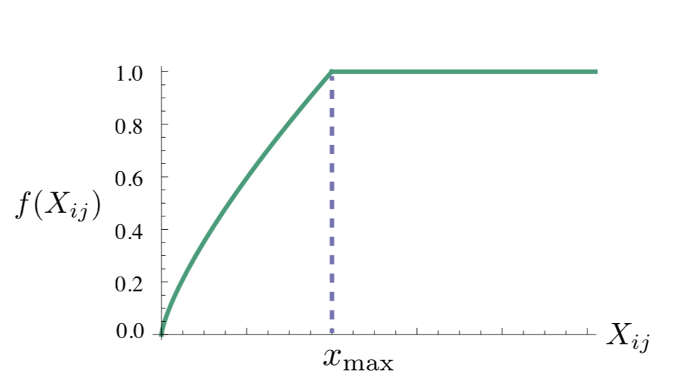
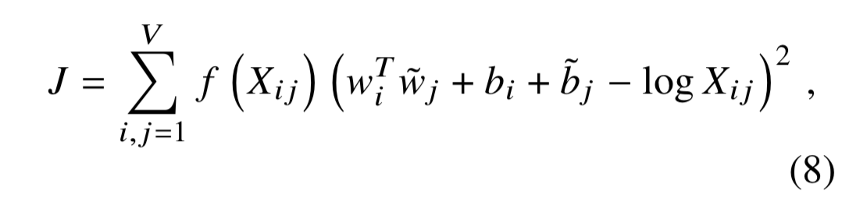
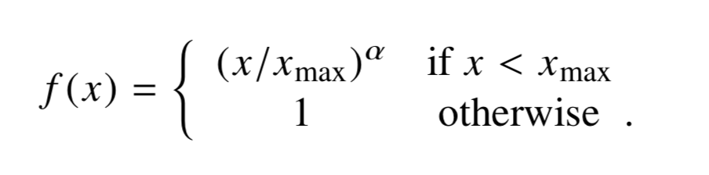
gloVe - objective
Notes:
Say that bias terms are not clearly explained in paper at all
Eq (1) is undefined when X_ik is zero. Instead cast it as a least squares objective.
Basically we are interested in some weighting function f(x_ij) such that minimizing the MSE is equivalent to minimizing the difference between the dot product and the log co-occurance (plus their biases), for each word, word co-occurance pair in the vocabulary.
The weighting function is the word,word co-occurance divided by the maximum co-occurance in the data. The ¾ power is empirical.

Slide 14
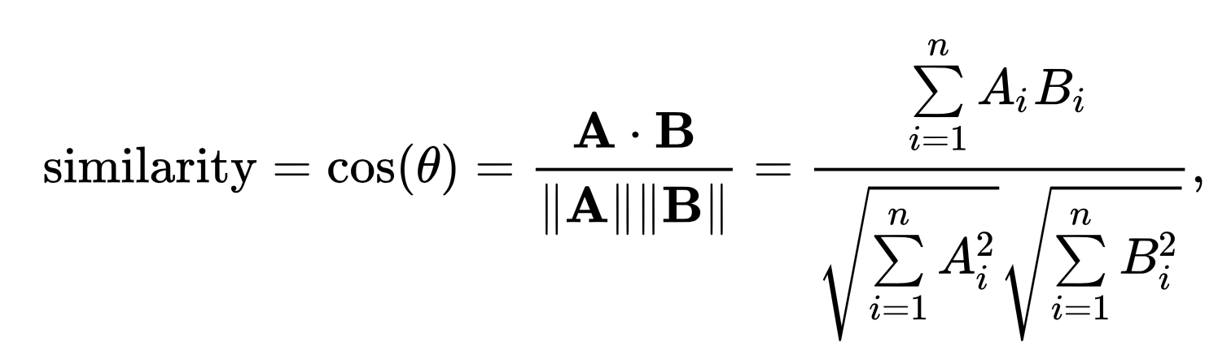
Word embeddings - similarity
Similarity between two words is calculated as:

Slide 15
word2vec & gloVe – weaknesses
Bias & temporality of word meanings
Differences in training and application data
Modeling sentences by their individual words
Out-of-vocabulary words
Polysemy

Slide 16
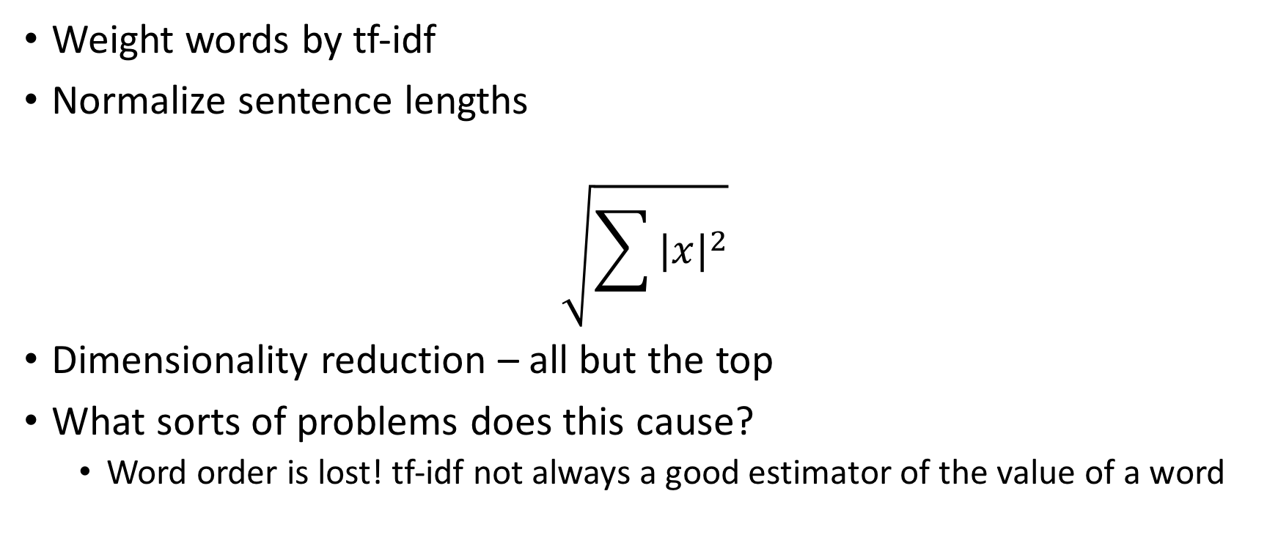
Word embeddings – modelling sentences

Slide 17
Word embeddings – new developments
Subword (character and moving window) embeddings with CNN or BiLSTM outputting a character-based word representation.
Transfer learning – contextualized vectors that augment embeddings based on pre-trained models
Dealing with out-of-vocabulary words
Mitigated with subword-level embeddings
Also can initialize weights for OOV words by summing the weights of their context words and then refine the weight
Notes:
http://ruder.io/word-embeddings-2017/

Slide 18
Papers
Doc2vec
Skip-thoughts vectors
Quick-thoughts vectors
Universal Sentence Encoder
Notes:
https://medium.com/huggingface/universal-word-sentence-embeddings-ce48ddc8fc3a

Slide 19
Distributed Representations of Sentences and Documents
Quoc Le
Tomas Mikolov
22 May 2014

Slide 20
Doc2vec
Paragraph Vector aka doc2vec paragraph2vec
Paragraphs, documents, and sentences are equivalent
Unsupervised algorithm that learns fixed-length feature representations from variable-length pieces of texts.
Concatenate paragraph vector with several word vectors from a paragraph and predict the following word in the given context
Trained through SGD and backpropagation

Slide 21
Doc2vec
Only difference from word2vec is that the weights depend on both words and documents in doc2vec.
Two approaches:
Distributed memory
Distributed bag of words

Slide 22
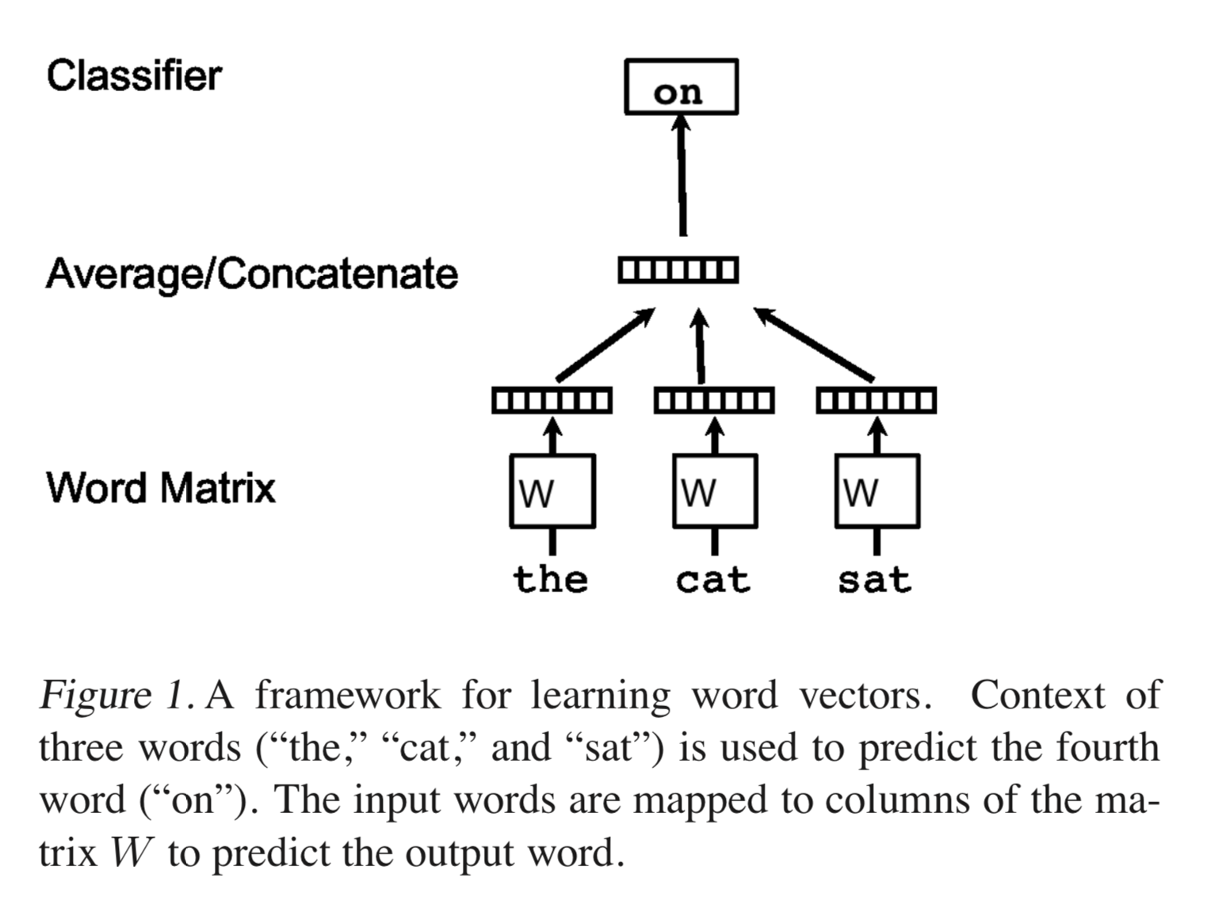
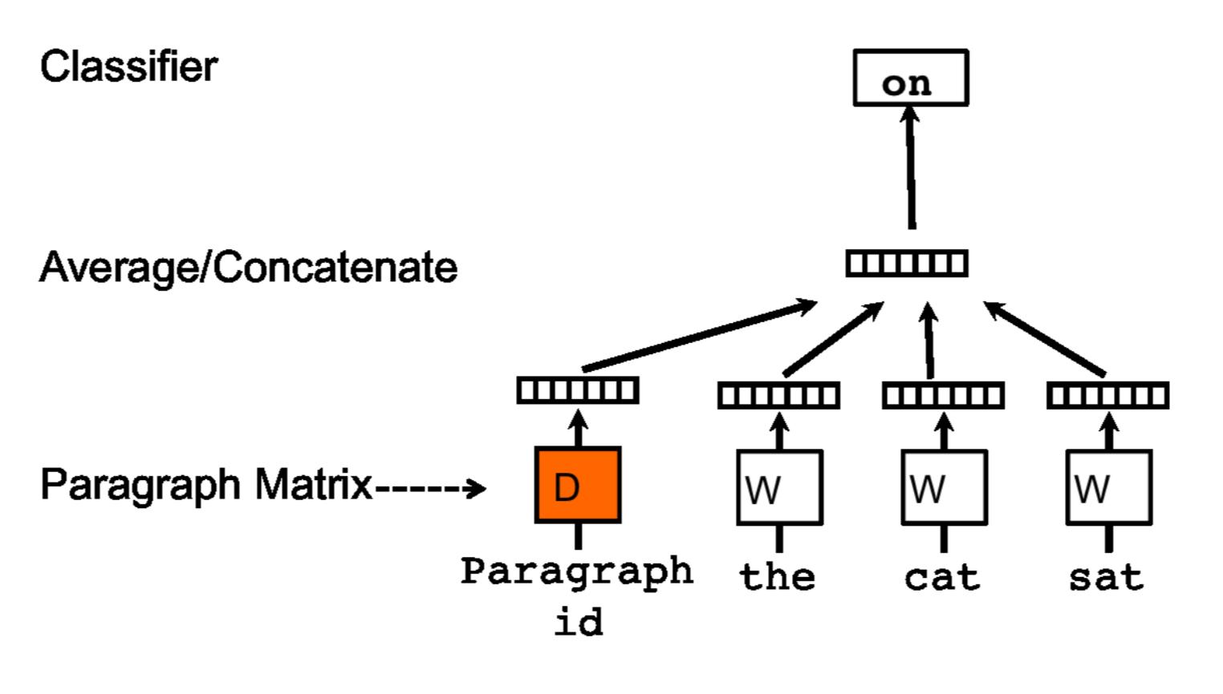
Doc2vec - Distributed memory
Paragraph vectors unique among paragraphs
Word vectors are shared
Prediction – paragraph vectors inferred by fixing the word vectors and training new paragraph vectors

Slide 23
Doc2vec - Distributed memory
Word vectors used in prediction task of the next word in a sentence
Initialized randomly
Output is two matrices, D documents and W words (shared). The D[] and W[] vectors are concatenated to predict word in a context.
At each step, sample a fixed-length context from a random paragraph, add in the paragraph vector, and predict the next word. Update the shared word vectors and the paragraph vector (shared with other contexts of the same paragraph)
Notes:
Randomly initialized word vectors and paragraph vectors are used to predict the next word in a sentence. At each training step, a fixed-length context is sampled from a random paragraph. The paragraph vector is shared across each context within paragraphs but not between paragraphs, and can be conceptualized as the topic of the paragraph. Over many training steps, many combinations of contexts from each paragraph converge to learn the embedding for the para- graph.

Slide 24
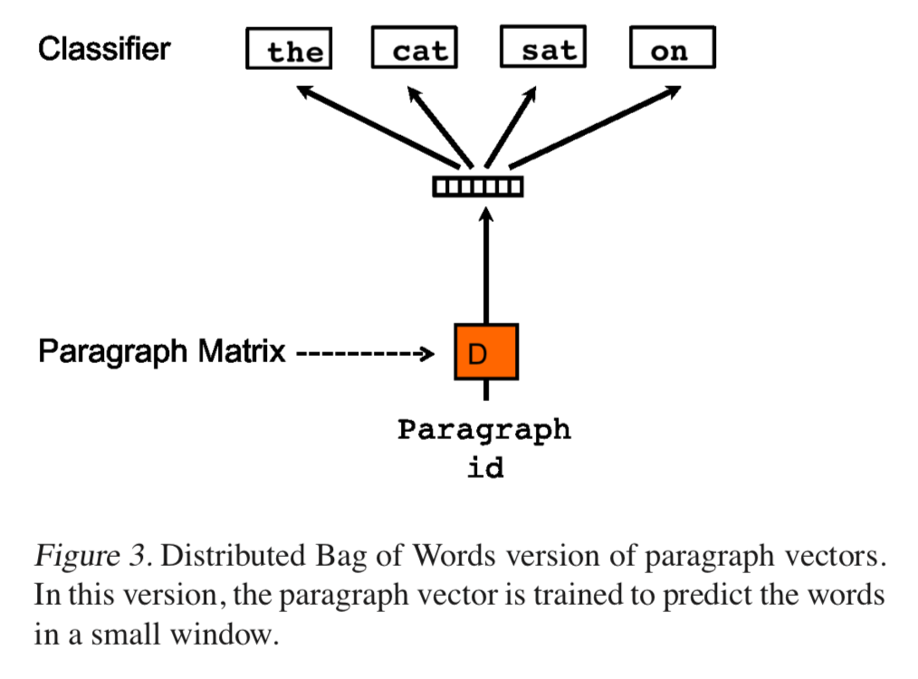
Doc2vec - Distributed bag of words
Ignore context words, sample a window of text and predict it given the paragraph matrix.
Ensemble distributed memory + distributed BOW
Notes:
shows the distributed bag of words approach to doc2vec. In this case, the objective is to predict randomly sampled words from the paragraph given the paragraph vector. This model is simpler, requires less storage, and is similar to the skip-gram approach in word2vec. While distributed memory tends to outperform distributed bag of words, the concatenation of both outperforms either individually. The authors thus recommend training both approaches and using concatenated paragraph embeddings for downstream tasks.

Slide 25
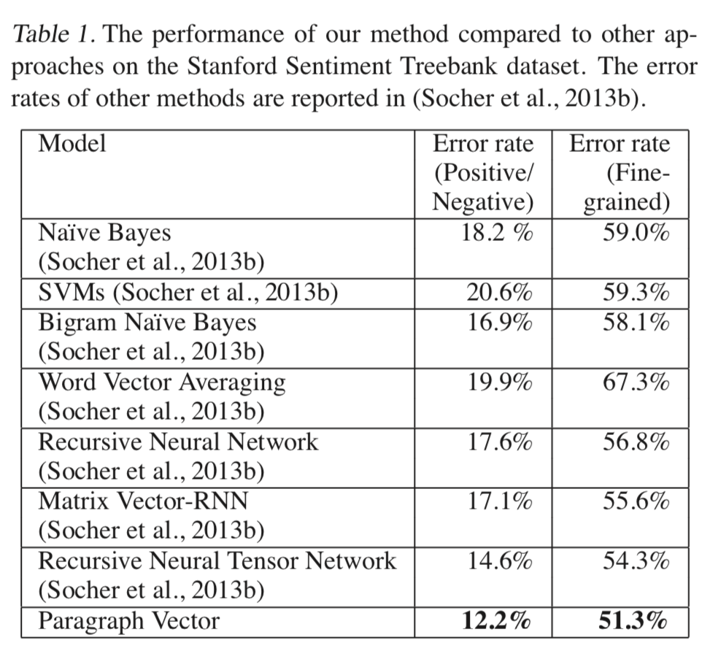
Doc2vec - Experiment – Sentiment analysis
Use paragraph vectors in logistic regression to predict movie rating
Choose window size with LOOCV of validation set (8)
Input: 7 word vectors + paragraph vector, predict 8th word
Shorter sentences are padded with NULL symbol.

Slide 26
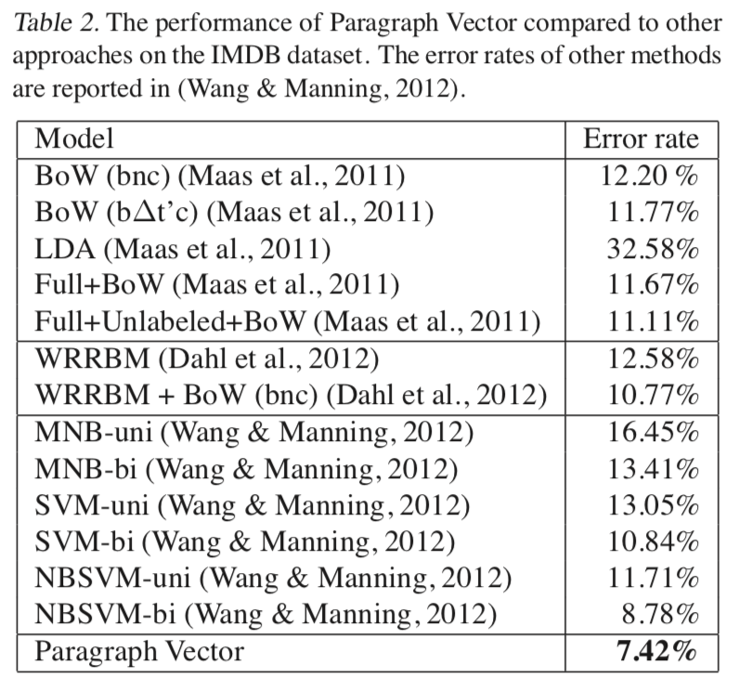
Doc2vec - Experiment – Sentiment analysis (IMDB)

Slide 27
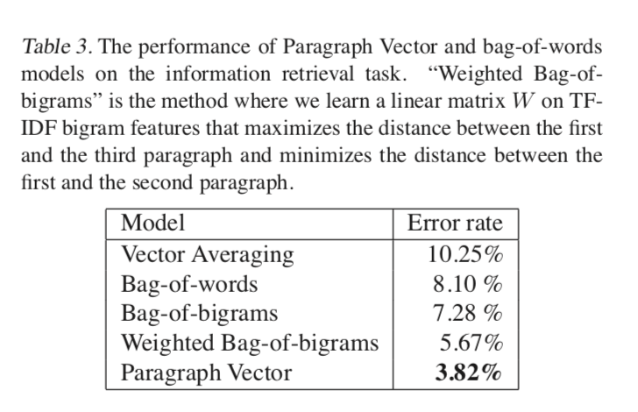
Doc2vec - Experiment - IR
1,000,000 most popular search queries – summarization paragraph of first 10 results
For each query – two paragraphs that are results, one that is randomly sampled
Identify which of the three are true results

Slide 28
Doc2vec - Prediction time
Add new columns to D and gradient descend on D while holding word vectors and softmax weights constant.

Slide 29
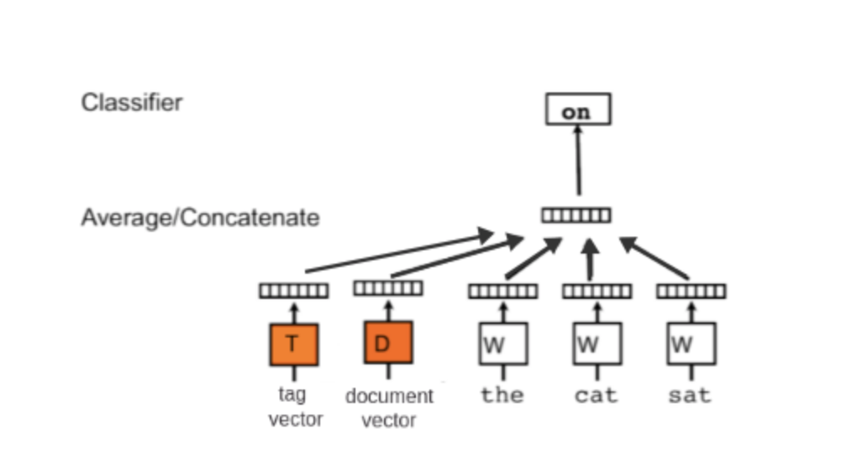
Doc2vec - supervised extension
https://medium.com/scaleabout/a-gentle-introduction-to-doc2vec-db3e8c0cce5e

Slide 30
Skip-Thought Vectors
Ryan Kiros, Yukun Zhu, Rusian Salakhutdinov, Richard Zemel, Antonio Torralba, Raquel Urtasun, Sanja Fidler
22 June 2015

Slide 31
Skip-Thoughts
Off-the-shelf unsupervised sentence encoder
Encoder-decoder model with goal to reconstruct surrounding sentences.
Similar sentences are mapped to similar vector representations
Vocabulary expansion
Evaluate on: semantic relatedness, paraphrase detection, image-sentence ranking, question-type classification, and sentiment and subjectivity

Slide 32
Skip-Thoughts
Many previous sentence embeddings used recursive, recurrent, and convolutional neural networks which were not generalizable
While doc2vec is generalizable, inference needs to occur during prediction
Abstract the skip-gram model to the sentence level
Depends on a contiguous training corpus
Trained on 11,000 free books

Slide 33
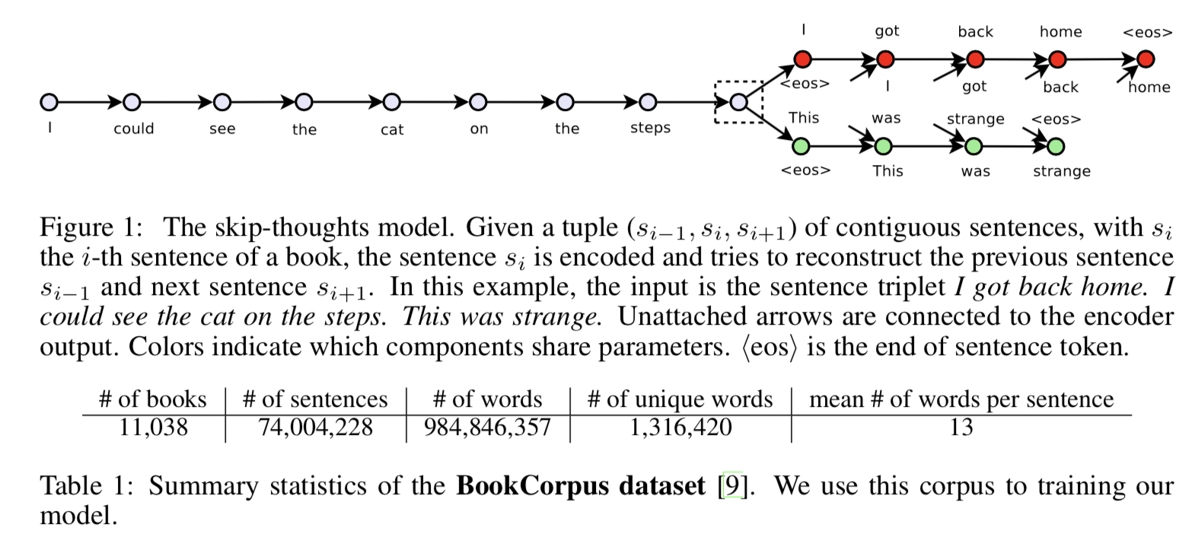
Skip-Thoughts

Slide 34
Skip-Thoughts - Approach
Encoder-decoder
Encoder maps words to sentences – RNN (GRU activation)
Decoder generates surrounding sentences – RNN (Conditional GRU)

Slide 35
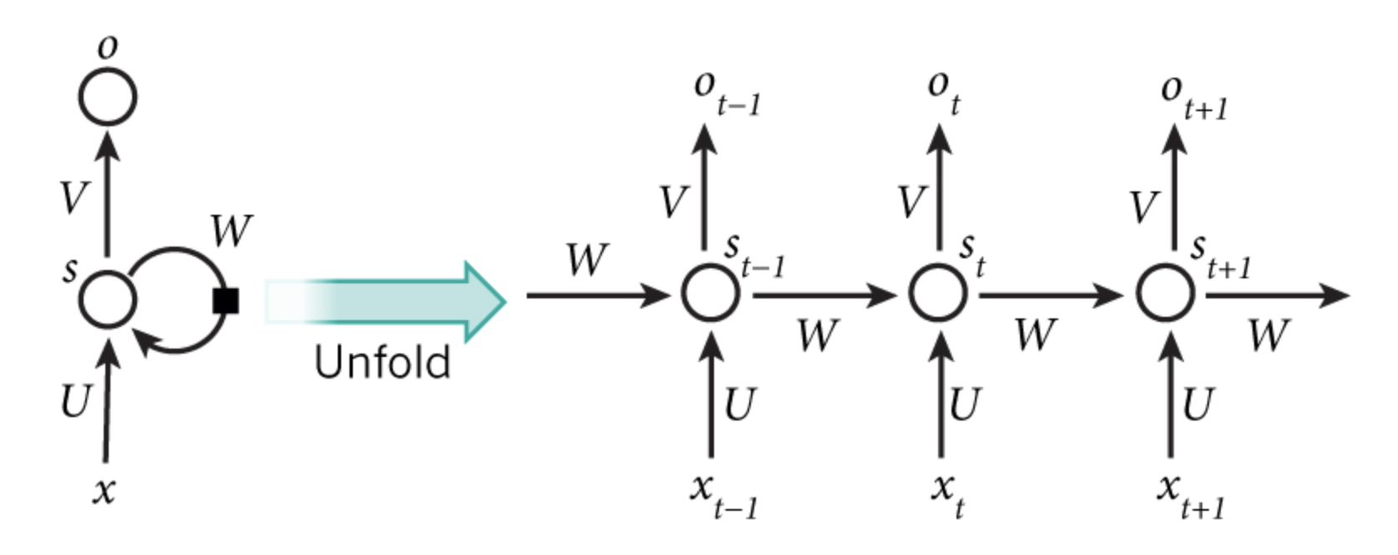
Crash course on gated recurrent units
Similar to LSTM but without an output gate
Aims to solve the vanishing gradient problem
U,V,W shared – allows generalizing to other lengths
Notes:
The vanishing gradient problem is basically that the neurons in earlier layers are learned very slowly because the gradients get smaller as we move backwards in the network.
http://www.wildml.com/2015/09/recurrent-neural-networks-tutorial-part-1-introduction-to-rnns/
X_t is the input at time step t. For example, could be a one-hot vector corresponding to the second word of a sentence.
S_t is the hidden state at time step t. It’s the “memory” of the network. s_t is calculated based on the previous hidden state and the input at the current step: f(Ux_t + W s_(t-1)) The function f is usually a nonlinearity such as tanh or ReLU.
O_t is the output at step t.
U,V,W are shared across all steps - reduces number of parameters and allows generalizing to other lengths.

Slide 36
Crash course on gated recurrent units
GRU has two gates: a reset gate and an update gate
Reset determines how to merge new input w/ memory
Update determines proportion of memory to keep
GRU with a reset gate of 1 and update of 0 is just an RNN
GRU has 2 gates instead of 3

Slide 37
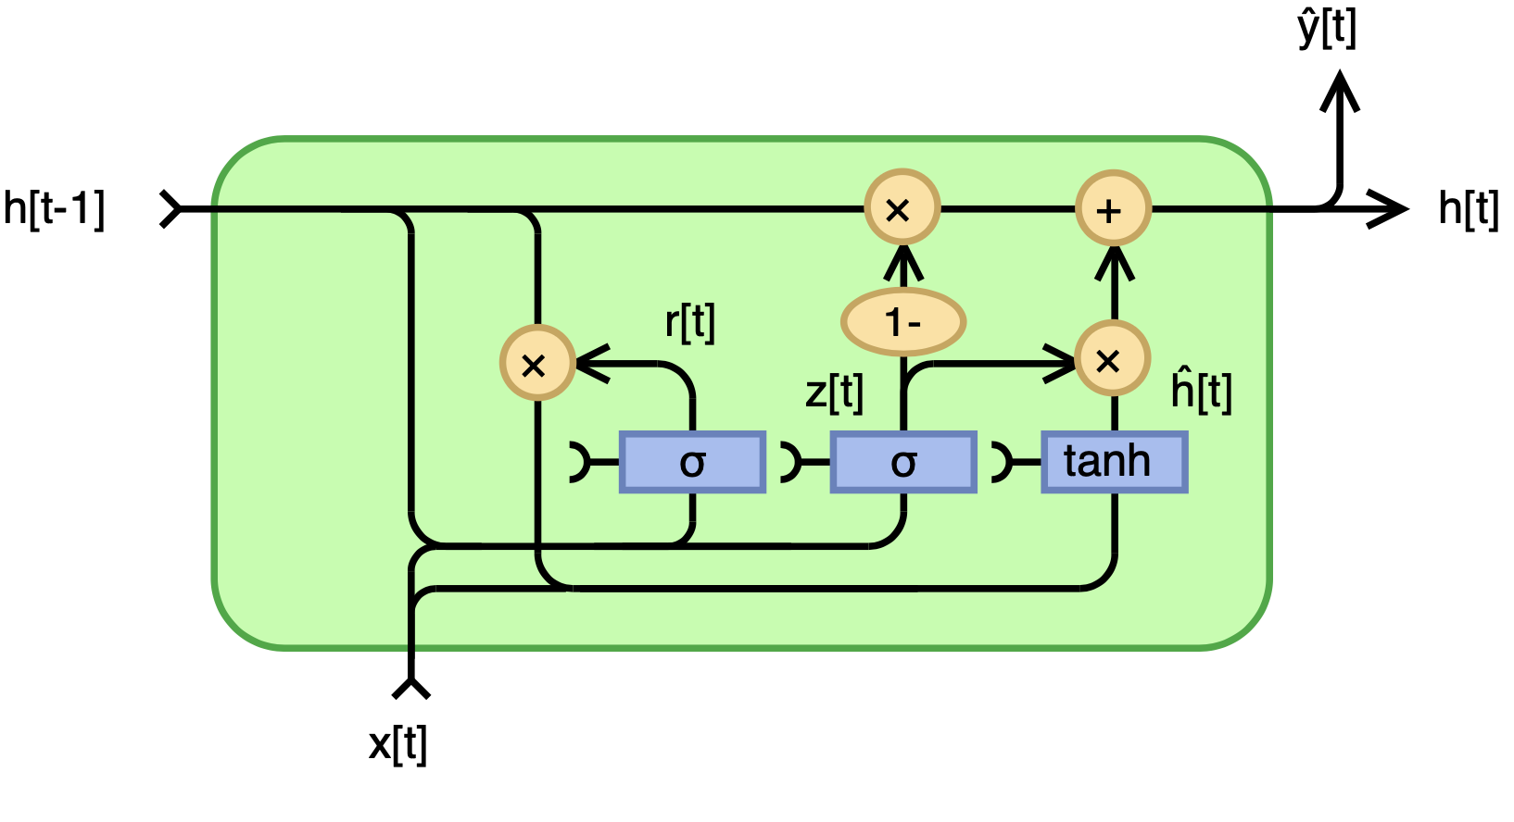
http://www.wildml.com/2015/09/recurrent-neural-networks-tutorial-part-1-introduction-to-rnns/
https://en.wikipedia.org/wiki/Gated_recurrent_unit#/media/File:Gated_Recurrent_Unit,_base_type.svg
Notes:
Z[t] is the update gate

Slide 38
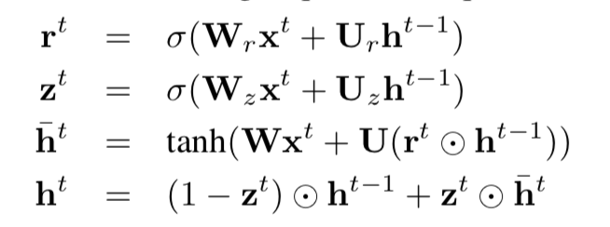
Skip-Thoughts - Encoder
w_{i}¹…w_{i}^{N} are the words in the sentence where N is the number of words in the sentence. x_{i}^{N} is the word2vec embedding.
Encoder produces a hidden state h_{i}^{t} which is the sentence representation up to word t. Thus h_{i}^{N} is the representation for the full sentence.
To encode a sentence, where h bar is the proposed state update, z is the update gate, and r is the reset gate.

Slide 39
Notes:
When x_t is plugged into the network unit, it is multiplied by its own weight W(z). The same goes for h_(t-1) which holds the information for the previous t-1 units and is multiplied by its own weight U(z). Both results are added together and a sigmoid activation function is applied to squash the result between 0 and 1
The forget gate and reset gate have similar formulas, but they differ in their usage.
The proposed state update, h bar is calculated as:
Multiply input by weight W and h(t-1) with weight U
Calculate element-wise product between reset gate and U(h_t-1)
This determines what to remove
Sum up steps 1 and 2, and apply tanh
The final memory, h^t, is a vector which determines what information for the current unit gets passed forward. This uses the update gate. Here you can see that z^t is element-wise product’ed with h bar_^t and h_(t-1)

Slide 40
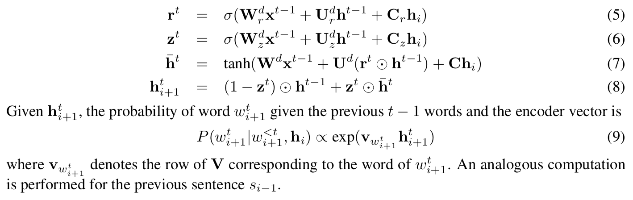
Skip-Thoughts - Decoder
Similar to encoder except introduce matrices C_{z}, C_{r}, and C. They bias the update, reset, and hidden states by the sentence vector.
One decoder for next sentence, another for previous sentence.
Separate parameters for each sentence except for vocabulary (V).

Slide 42
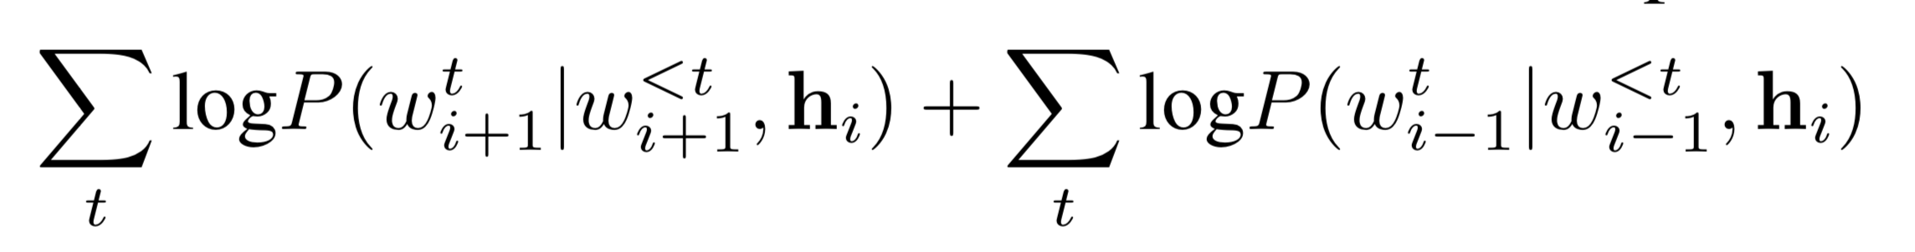
Skip-Thoughts - Objective
Given a tuple, objective is sum of log probabilities of surrounding sentences conditioned on the encoder.

Slide 43
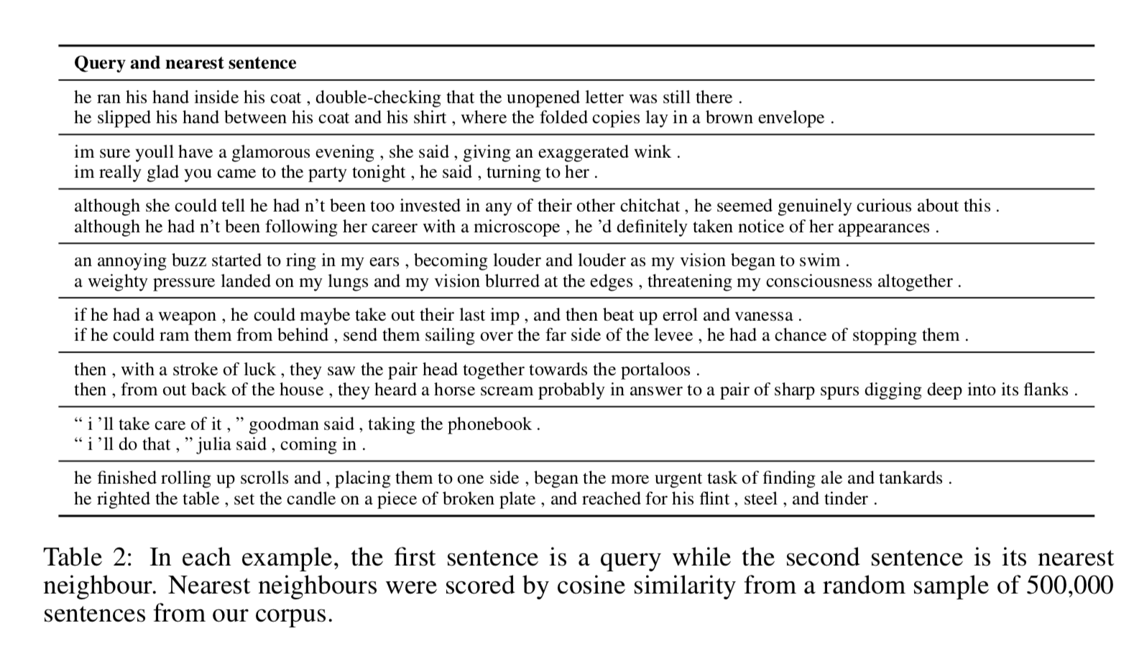

Slide 44
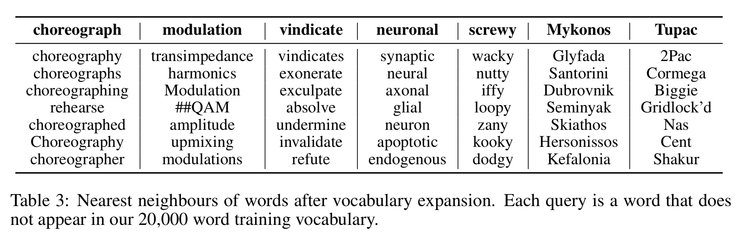
Skip-Thoughts – out-of-vocabulary words
Learn CBOW word2vec and linearly map new words to the encoder vocabulary space, learned using all shared words.
Notes:
SKip-thoughts also introduces a mechanism to expand vocabulary to incorporate OOV. It does so by using an un-regularized L2 linear regression for the matrix W that maps the word2vec vocabulary to the RNN vocabulary. W is simply equal to the encoder vocabulary space divided by the word2vec embedding space.

Slide 45
Skip-Thoughts - Evaluation
Tested on eight tasks: semantic relatedness, paraphrase detection, image-sentence ranking, classification, and 4 different sentiment and subjectivity tests.
A linear classifier with no fine-tuning or back-propagation or feature engineering is used.
Uni-direction, bi-directional, and combine (concatenated) model are tested.

Slide 46
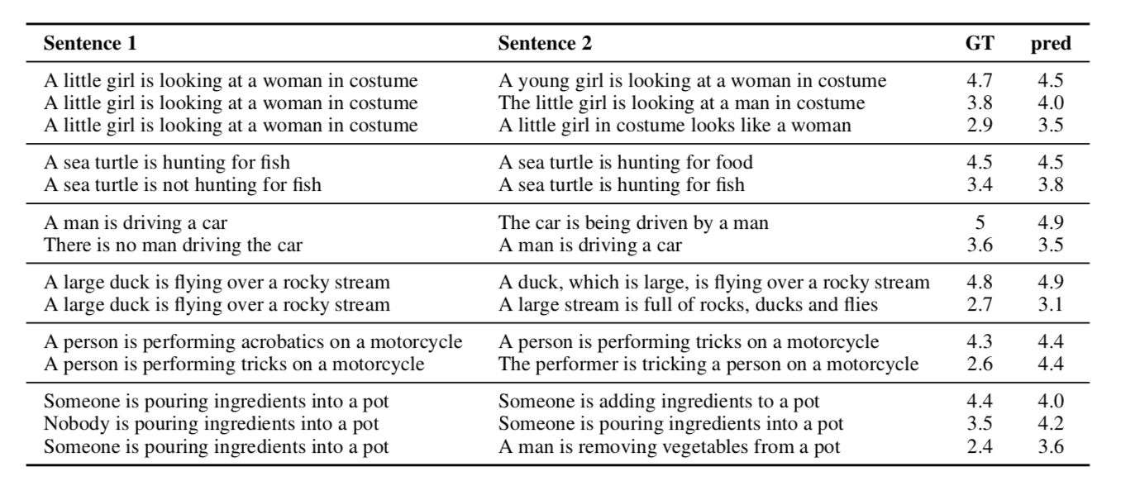
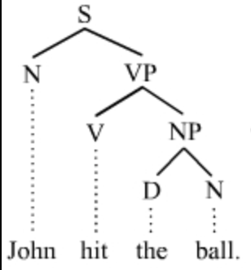
Skip-Thoughts - Evaluation
Semantic relatedness: Given two sentences, generate a score of how related the sentences are.
ST (combine): 0.8655, SoA: 0.867
Notes:
SoA is a dependency-tree LSTM using a parse tree

Slide 47
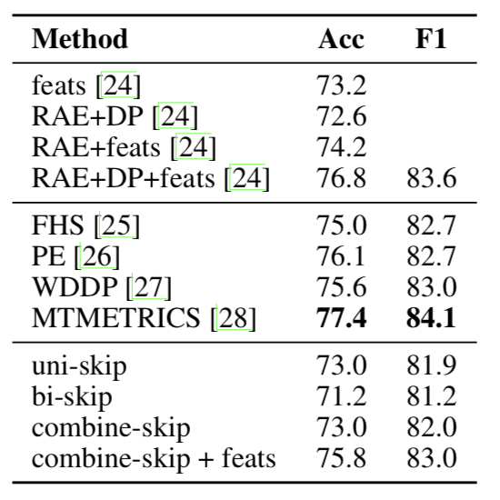
Skip-Thoughts - Evaluation
Paraphrase detection: Given two sentences, predict whether one is a paraphrase of the other.
Notes:
Combine-skip has simple sentence statistics.
State-of-art is a SVM using machine-translation metrics like BLEU

Slide 48
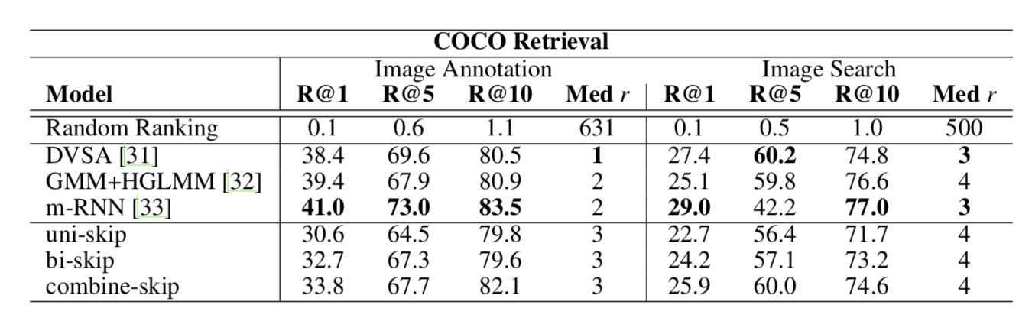
Skip-Thoughts - Evaluation
Image-sentence ranking: COCO dataset, five human-generated captions
Rank annotations given image
Rank image given annotation

Slide 49
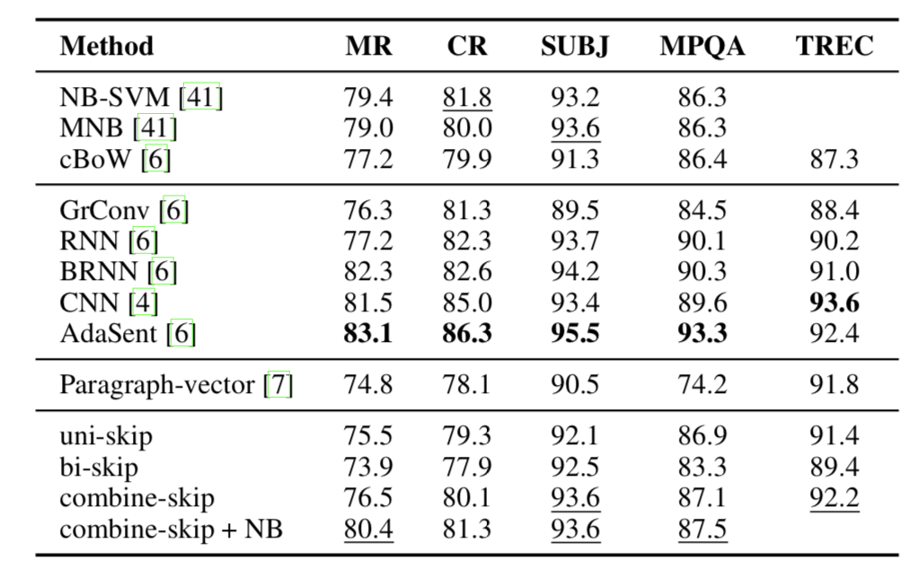
Skip-Thoughts - Classification
Movie sentiment (MR), customer product reviews (CR), subjectivity (SUBJ), opinion polarity (MPQA), question-type (TREC).
All classification done with logistic regression w/ L2 regularization

Slide 50
An efficient framework for learning sentence representations
Lajanugen Logeswaran, Honglak Lee
22 Feb, 2018

Slide 51
Quick thoughts
Unsupervised sentence representations
Classifier distinguishes context sentences from other sentences

Slide 52
Quick thoughts
Issues with previous sentence embeddings:
Numerous ways of expressing an idea
Semantic representation should be insensitive to form
Existing models reconstruct surface form, modeling irrelevant aspects
High computational cost - softmax over entire vocabulary

Slide 53
Quick thoughts
Generative objective replaced by discriminative approximation - model attempts to identify embedding of a correct context target given a set of candidate sentences.
The “meaning” of sentence is the information that allows it to predict the information of context sentences.

Slide 54
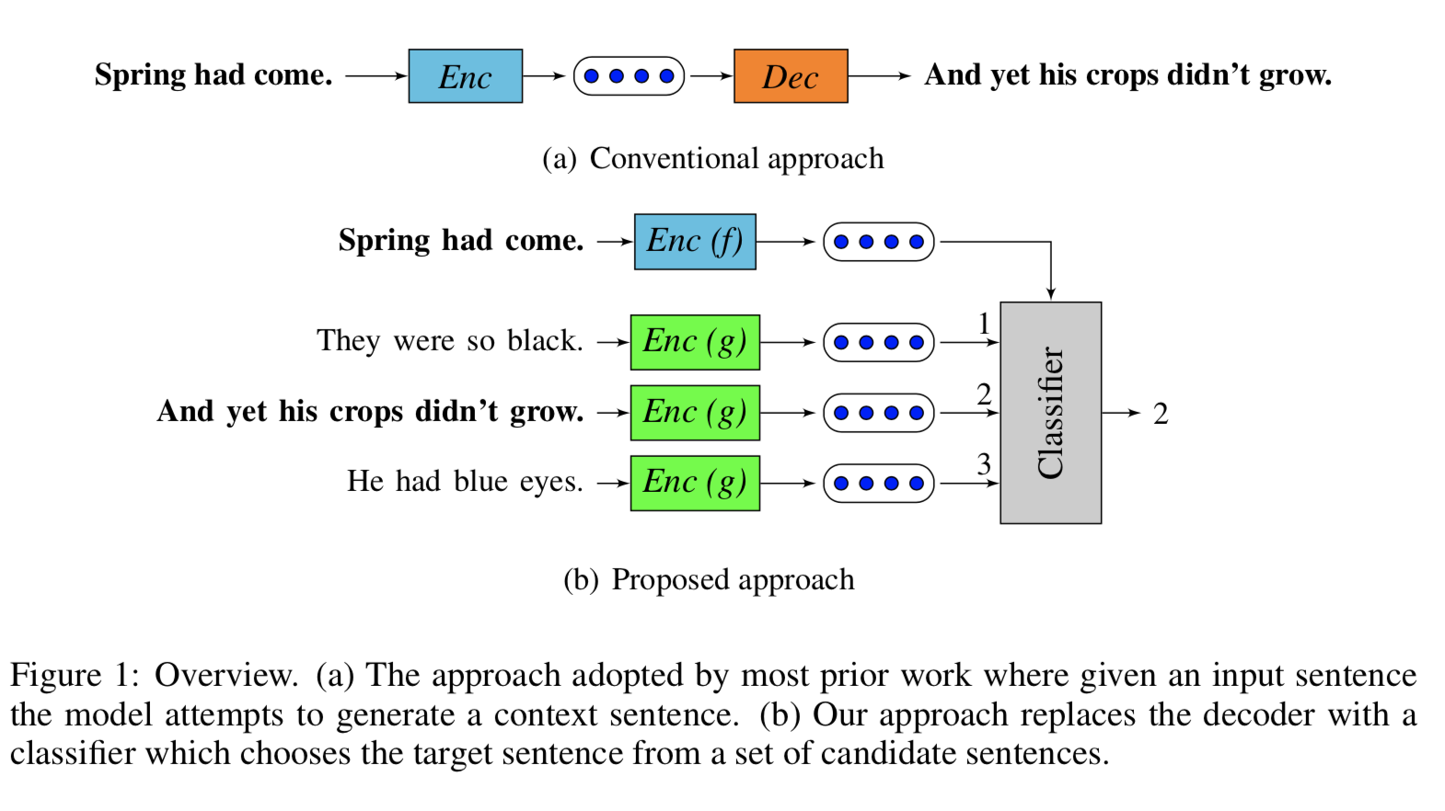
Quick thoughts

Slide 55
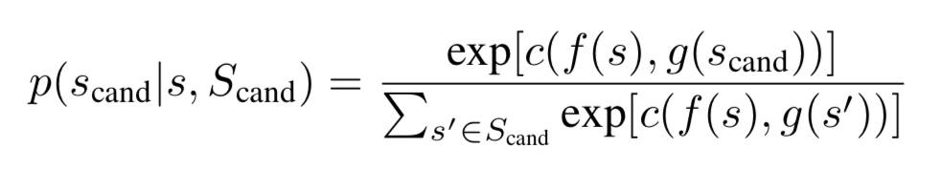
Quick thoughts - Process
Encode input sentence and candidate context sentences, without sharing parameters, then use input sentence to differentiate context. This allows model to ignore irrelevant aspects of input sentence.
f(x) and g(x) are RNNs with GRU activation.
Notes:
For a given sentence position in the context of little s (the next sentence), the probability that a candidate sentence is the correct sentence is given by the function, where c is a scoring function or classifier, that is the inner product of the u,v parameter matrices.

Slide 56
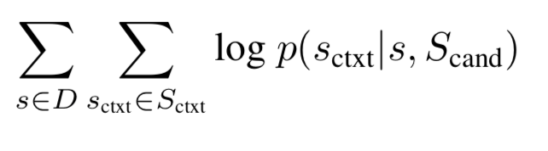
Quick thoughts - objective
Maximize the probability of classifying context sentences correctly, for each sentence in D.
C as an inner product is empirical - keeping it simple encourages the encoder to learn better representations rather than relying on the classifier.

Slide 57
Quick thoughts - training
Minibatch of random samples of contiguous sentences. For each sentence, all other sentences are candidate context sentences for classification. Context size of 3 was used, with a batch size of 400.
Word embeddings randomly initialized from U[-0.1,0.1]. GRU weights uniformly initialized and gate biases initialized to 1.
Trained on BookCorpus (7000 novels) and UMBC corpus (100M web pages).

Slide 58
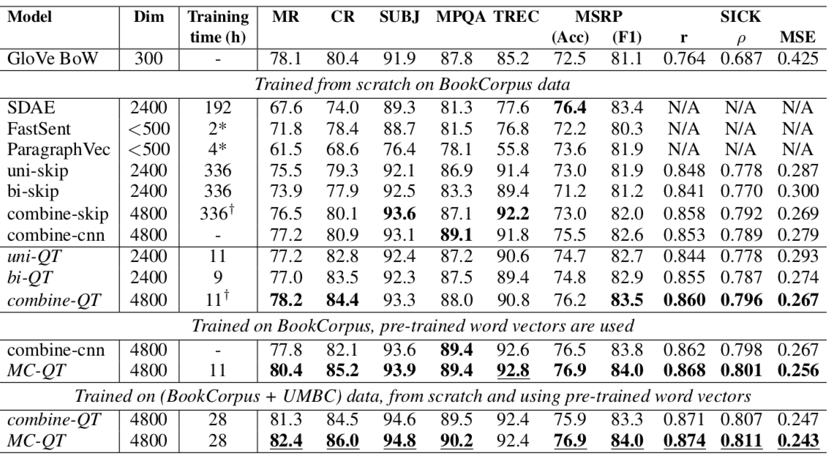
Quick thoughts - Evaluation
Movie review sentiment (MR)
Product reviews (CR)
Subjectivity (SUBJ)
Opinion polarity (MPQA)
Question type classification (TREC)
Paraphrase identification (MSRP)
Notes:
Baseline is GloVe. FastSent is Hill et al. 2016, paragraph vectors, skip thoughts (uni-skip and bi-skip), CNN of Gan et al. 2016 (skip thoughts but with CNN instead of RNN)
Uni-QT model uses uni-directional RNNs as encoders for f and g. Bi-qt concatenates final hidden states of two RNNs, each bidirectional. Combine qt concatenates representations of uni and bi models.
SDAE is a de-noising auto-encoder.
MC-QT (multi-channel quick thoughts) - uses pre-trained vectors and is the conccatenation of two bi-direcitonal RNNS. one of them uses fixed pre-trained word embeddings (3M vocavb) while the other uses tunable word embeddings from scratch (50K vocab). The different input representations discover less redundant features. GloVe are the pre-trained embeddings.
BookCorpus + UMBC shows economies of scale.
Training time is on a GTX Titan X. Quick thoughts fit within 3GB of GPU memory.

Slide 59
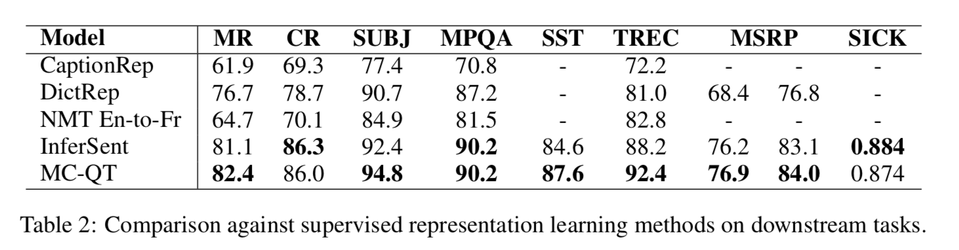
Quick thoughts - vs supervised
Notes:
Infersent model is trained on NLI task. SST is stanford sentiment treebank.

Slide 60
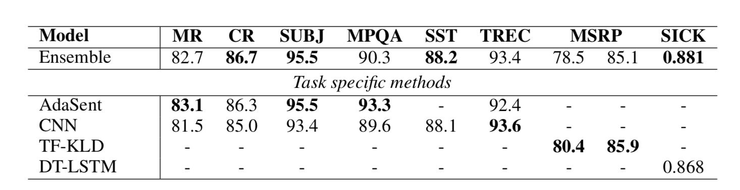
Quick thoughts - vs task-specific supervised
Ensemble are weighted average of predicted log-probabilities of individual models by their normalized validation set performance.
Models are different model types, embeddings, and datasets
Notes:
This paper’s models are a linear classifier on fixed pre-trained embeddings, while the task-specific methods are tuned end-to-end with feature engineering

Slide 61
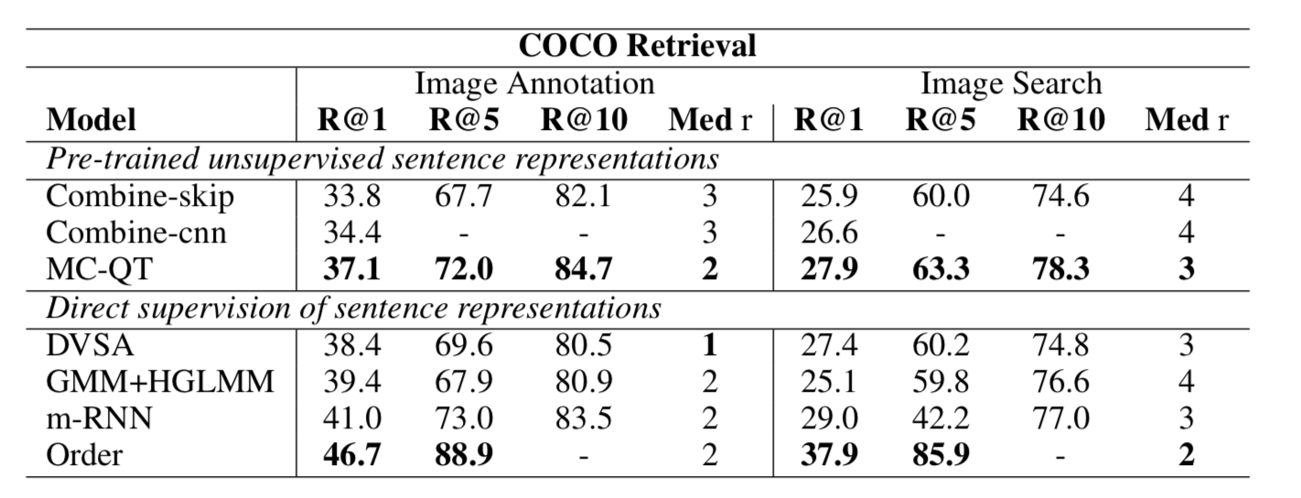
Quick thoughts - image-caption retrieval
Notes:
The task here is image-sentence ranking, in the same way as was done in the skip thoughts paper, with COCO data and 113k/5k/5k train val test split.

Slide 62
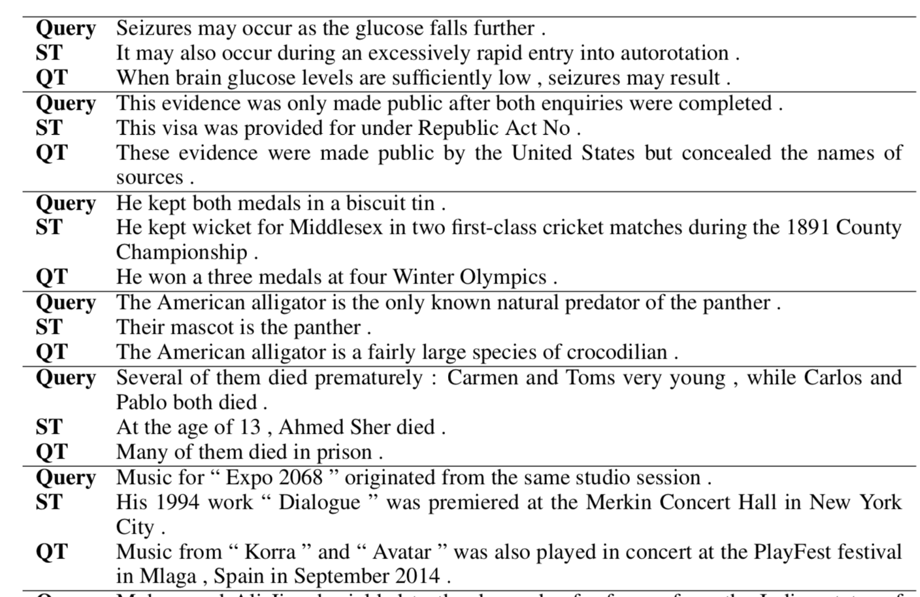
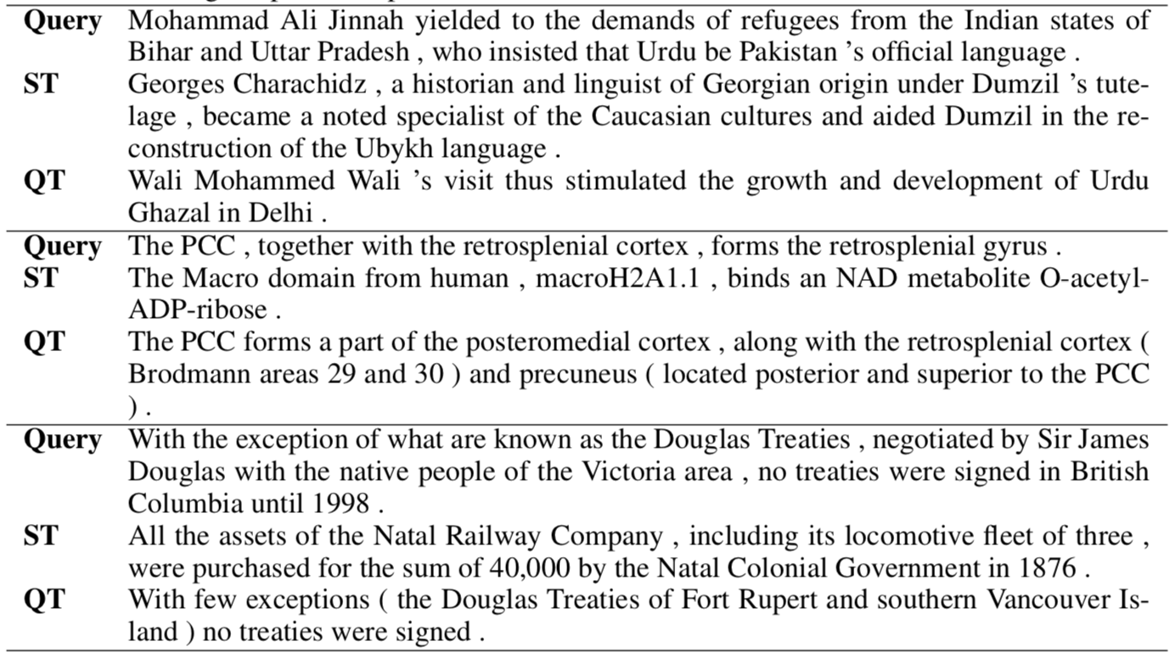
Quick thoughts - Nearest neighbors
Notes:
1 million sentences from a wikipedia dump

Slide 63
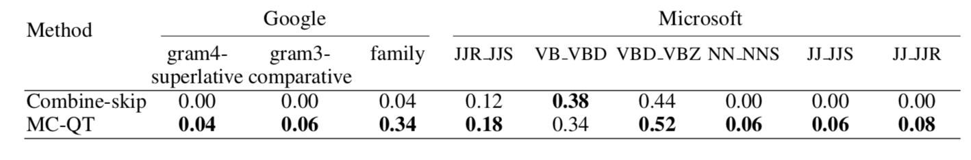
Quick thoughts - analogy making
The goal of analogy making is to fill in the following blank:
If A is to B, then C is to ____
The approach:
v(C) + v(B) - v(A) identifies closest sentence vector to v(D)
Notes:
1300 tuples of sentences from Yelp. For each tuple, derive 4 questions by considering three of hte sentences to form the query vector.

Slide 64
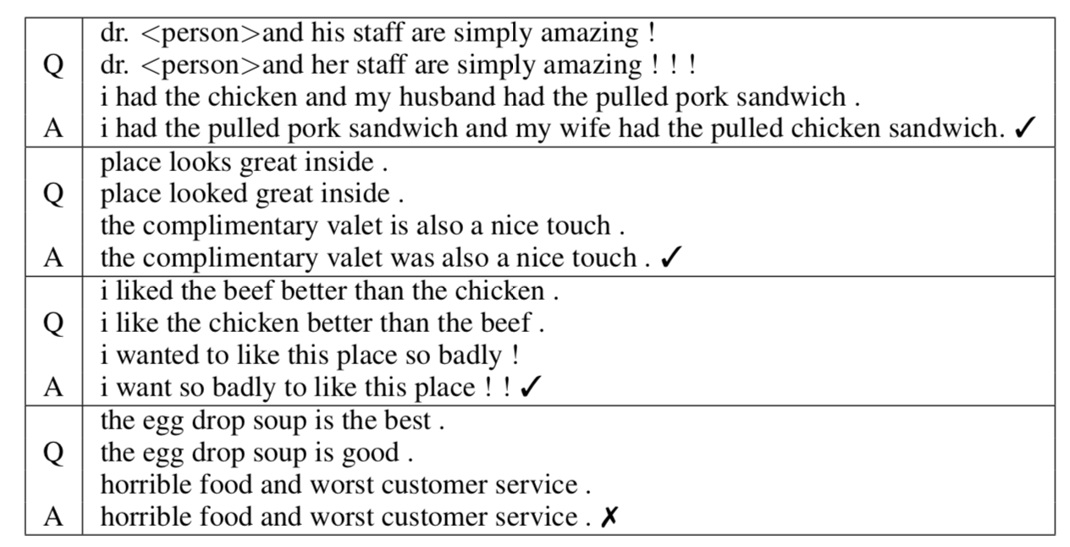
Quick thoughts - analogy making

Slide 65
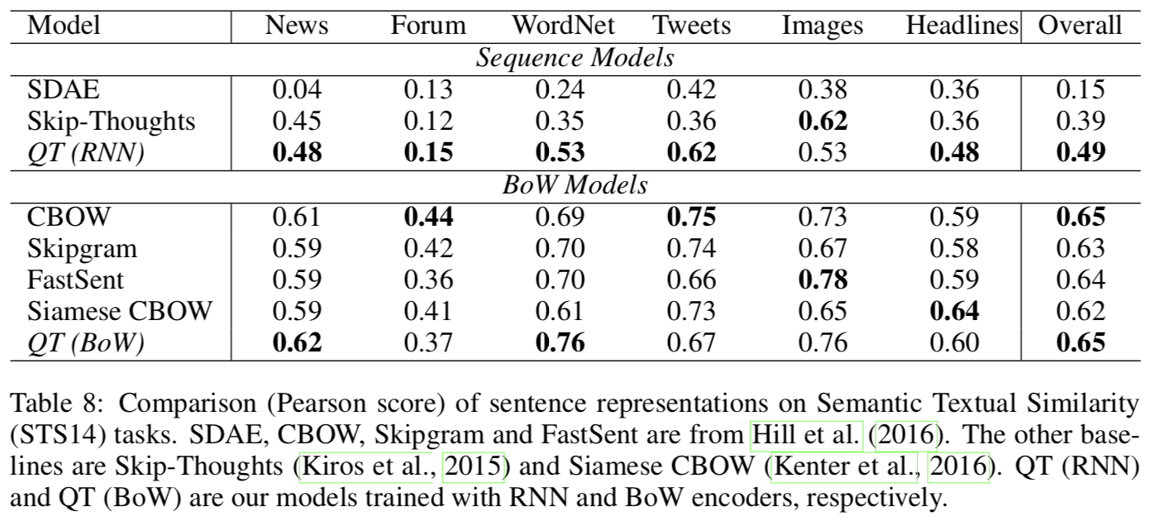
Quick thoughts - Semantic textual similarity
Notes:
QT (RNN) is the same as the combine-QT from table 1.
Bag of word encoder just does the same thing but with a normal shallow network instead of an RNN - 2 hour training time on Titan X.

Slide 66
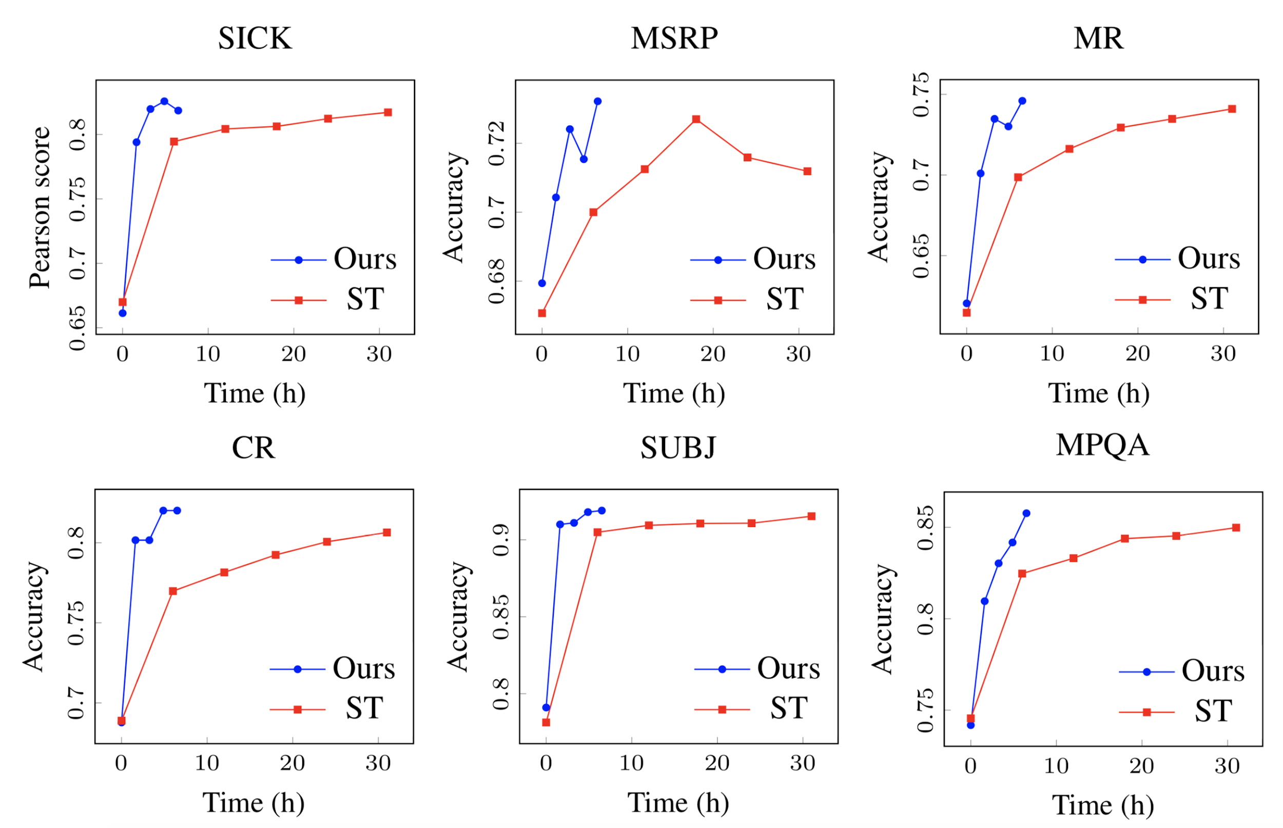
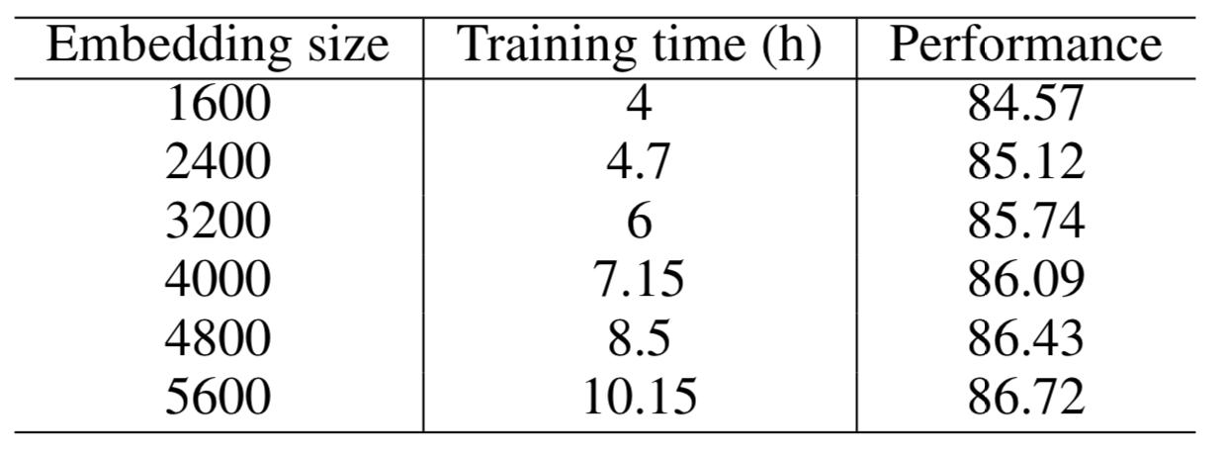
Quick thoughts - training efficiency
Notes:
Train same encoder architecture with QT and ST, using a pared down ST with 1000 hidden states and 300 dimension word embeddings.
QT has 20M parameters, ST has 58M. QT trains 5x faster than ST (6.5 hours vs 31 hours).

Slide 67
Universal Sentence Encoder
Daniel Cer, Yinfei Yang, Sheng-yi Kong, Nan Hua, Nicole Limtiaco, Rhomni St. John, Noah Constant, Mario Guajardo-Cespedes, Steve Yuan, Chris Tar, Yun-Hsuan Sung, Brian Strope, Ray Kurzweil
12 April, 2018

Slide 68
Universal Sentence Encoder
Sentence embeddings designed for transfer learning to other tasks, targeting weaknesses in applying pre-trained embeddings to new tasks or corpuses.
Two models available on TF Hub - one using transformer architecture, the other using a deep averaging network.

Slide 69
Transformer architecture (2017)
Replacement for using an encoder-decoder RNN or CNN.
Attention mechanisms allow modelling of dependencies between words without regard to distance. Most of the time, though, these are used in conjunction with RNN, so they still cannot be parallelized.
The transformer relies entirely on self-attention, which relates different positions of a sequence in order to calculate a representation.
Notes:
Self attention [8] provides an alternative to RNN architectures, which are slower and more computationally intensive. Because RNNs are sequential, it is impossible to learn representations in parallel. Additionally, RNNs do not adequately model long-term dependencies, such as when a word’s meaning depends upon a word many words before or after it in the phrase. The forget gate in an RNN cell determines how much of all previous information to pass to the next cell, and does not allow individual words to be retained for longer than others.
The transformer [8] directly learns these dependencies rather than relying on the hidden state and the forget gates. In other words, the transformer removes the dependence on the distance between words when modeling dependencies between words.

Slide 70
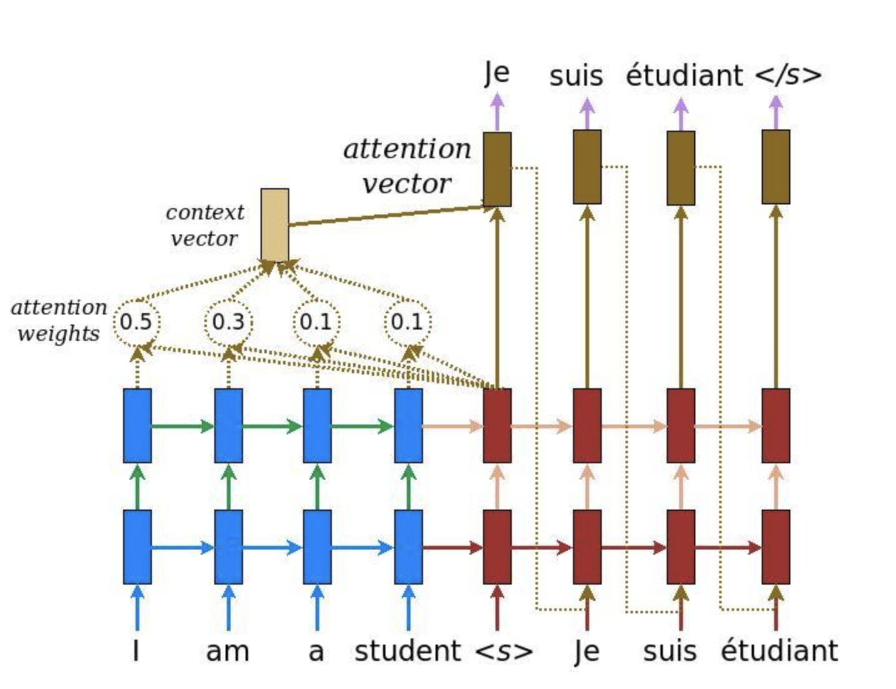
Attention
https://medium.com/syncedreview/a-brief-overview-of-attention-mechanism-13c578ba9129
Notes:
The transformer is an extension of the attention mechanism, which simply uses the hidden state from every cell to create a context vector that is combined with the encoder output as input to the decoder.

Slide 71
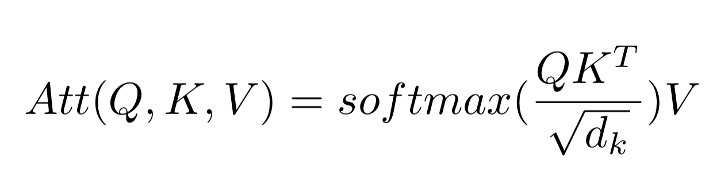

Transformer architecture
Encoder has two sub-layers, a self-attention mechanism and a feed-forward network. Both of these are normalized.
Decoder also has a third layer that does multi-head attention over the output of the encoder. Output shifted by one position so they only depend on previous outputs.
Residual connections
Notes:
The transformer attends over keys, values, and queries instead of word tokens. Typically, the keys and values are the encoder hidden states, while the query is the previous output of the decoder. Different linear transformations are applied to the output of the scaled dot-product attention with the formula in 1.2 to each "head" of attention. The number of heads is a tuning parameter, and having multi-head attention allows the model to weight the representation subspaces rather than simply averaging them. The multi-head attention is combined with feed-forward layers to construct an encoder-decoder model as shown in figure X.

Slide 72

Transformer architecture
Attention - “mapping a query and… key-value pairs to an output, where the queries, keys, values, and output are all vectors. The output is computed as a weighted sum of values, where the weight… is a compatibility function of the query and key.”(Vaswani et al., 2017).
Notes:
Input - queries and keys, compute the dot product between query and keys, scale by square root, and softmax to obtain weights
In practice, this is done in parallel, queries are packed together into matrix Q, and keys and values are packed together into K and V. The matrix of outputs is the softmax of QK^T/square root of dimension and multiply by the values.
D_k, the number of dimensions, is a learned parameter.
Multi-head attention allows to jointly attend to info from different representation subspaces at diferent positions.
Attention is used in 3 ways:
In encoder-decoder attention layers, queries come from previous decoder layer, and the memory keys and values are the output of the encoder.
The encoder’s self-attention layer has K,V,Q all from same place: output of previous layer. Decoder is the same.

Slide 73

Deep averaging network (2015)
Notes:
The deep averaging network (DAN) [3] is a simple bag of words deep neural network that performs similarly to syntactically-aware models.
DAN averages input word embeddings for a sequence, passes the average through feed-forward layers, and then linearly classifies the final layer’s representation. In lieu
of drop- out layers, DAN randomly drops a proportion of the input word embeddings before computing the average for each epoch.
DAN is a much simpler model than recurrent neural networks, with vastly fewer parameters and softmax computations. Despite this relative simplicity, DAN perform similarly to recurrent networks on sentiment classification and question answering.

Slide 74
Universal Sentence Encoder - Transformer
Transformer uses attention to create context aware representations of words accounting for word order and identity of all other words. The word representations are concatenated to a fixed-length sentence encoding by element-wise sum of representations.
Designed to be general - multi-task learning, single encoding feeds a skip-thought task, conversation input-response, and supervised classification.

Slide 75
Universal Sentence Encoder - DAN
Word embeddings averaged and passed to feed-forward DNN to produce embeddings.
Also done with multi-task learning
Advantage over transformer: compute time and linearity between compute time and length of input

Slide 76

Universal Sentence Encoder
Trained on wikipedia dump, web news, forums, and SNLI corpus
MR: Movie review
CR: Sentiment from customer review
SUBJ: Subjectivity of sentences from movie reviews
MPQA: Phase-level opinion polarity from news data
TREC: Fine grained question classification
SST: Binary phrase-level sentiment classification
STS Benchmark: Semantic textual similarity between pairs
WEAT: word pairs from psychology literature

Slide 77
Universal Sentence Encoder - Transfer Learning
Output of transformer and DAN fed to task-specific DNN, except for pairwise semantic similarity which is arccos of cosine similarity
Baseline: Only word-level transfer (w2vec), or no transfer learning

Slide 78

Universal Sentence Encoder

Slide 79

Universal Sentence Encoder - WEAT

Slide 80



Universal Sentence Encoder - Performance

Slide 81
Summary
Unsupervised sentence embeddings have improved the state of the art accuracy over word2vec and gloVe for a variety of tasks
Sentence embeddings capture meaning missed by character and word embeddings, through word order and sentence context
Sentence embeddings range from conceptually simple (doc2vec, quick thoughts) to complex (universal sentence encoder)

Slide 82
Discussion
Advantages and disadvantages of generative vs. discriminative sentence embeddings
Sentence-level version of gloVe?
Is the next step to fit everything together? Attention + ELMO + QT?
Why is attention a better choice to recurrent networks? Is it a true successor or a divergence?
When to use which sentence embedding?

Slide 83
Discussion
Both quick thoughts and the universal sentence encoder make strong arguments for computational efficiency. As cloud computing gets ever-cheaper, neural architectures become more complicated.
Curiosity-driven networks, where the change in prediction error is the loss function, have recently shown effectiveness in robotic and predictive AI tasks.
Could a curiosity-driven NLP task force algorithms to learn meaning (e.g. not the surface form of sentence structures)?
Advancements in innovation and efficiency versus advancements in computational power - long and short-term impact
Tripling parameter count for a 0.5% accuracy increase

Slide 84
References
[1] Daniel Cer et al. “Universal Sentence Encoder”. In: CoRR abs/1803.11175 (2018). arXiv: 1803.11175. url: http://arxiv.org/abs/1803.11175.
[2] Kyunghyun Cho et al. “Learning Phrase Representations using RNN Encoder– Decoder for Statistical Machine Translation”. In: Proceedings of the 2014 Conference on Empirical Methods in Natural Language Processing (EMNLP). Doha, Qatar: Association for Computational Linguistics, Oct. 2014, pp. 1724– 1734. url: http://www.aclweb.org/anthology/D14-1179.
[3] Mohit Iyyer et al. “Deep Unordered Composition Rivals Syntactic Meth- ods for Text Classification”. In: Proceedings of the 53rd Annual Meeting of the Association for Computational Linguistics and the 7th International Joint Conference on Natural Language Processing of the Asian Federa- tion of Natural Language Processing, ACL 2015, July 26-31, 2015, Bei- jing, China, Volume 1: Long Papers. 2015, pp. 1681–1691. url: http: //aclweb.org/anthology/P/P15/P15-1162.pdf.
[4] Ryan Kiros et al. “Skip-Thought Vectors”. In: CoRR abs/1506.06726 (2015). arXiv: 1506.06726. url: http://arxiv.org/abs/1506.06726.
[5] Quoc V. Le and Tomas Mikolov. “Distributed Representations of Sentences and Documents”. In: ICML. Vol. 32. JMLR Workshop and Conference Proceedings. JMLR.org, 2014, pp. 1188–1196. url: http://dblp.uni- trier.de/db/conf/icml/icml2014.html#LeM14.
[6] Lajanugen Logeswaran and Honglak Lee. “An efficient framework for learn- ing sentence representations”. In: International Conference on Learning Representations. 2018. url: https://openreview.net/forum?id=rJvJXZb0W.
[7] Tomas Mikolov et al. “Distributed Representations of Words and Phrases and their Compositionality”. In: Advances in Neural Information Process- ing Systems 26. Ed. by C. J. C. Burges et al. Curran Associates, Inc., 2013, pp. 3111–3119. url: http://papers.nips.cc/paper/5021- distributed - representations - of - words - and - phrases - and - their - compositionality.pdf.
[8] Ashish Vaswani et al. “Attention is All you Need”. In: Advances in Neural Information Processing Systems 30. Ed. by I. Guyon et al. Curran Asso- ciates, Inc., 2017, pp. 5998–6008. url: http://papers.nips.cc/paper/ 7181-attention-is-all-you-need.pdf.

